Slide 1

New Member Webinar
February 6, 2025
2025 @NAEA All Rights

Slide 2


Welcome
2025 @NAEA All Rights

Slide 3
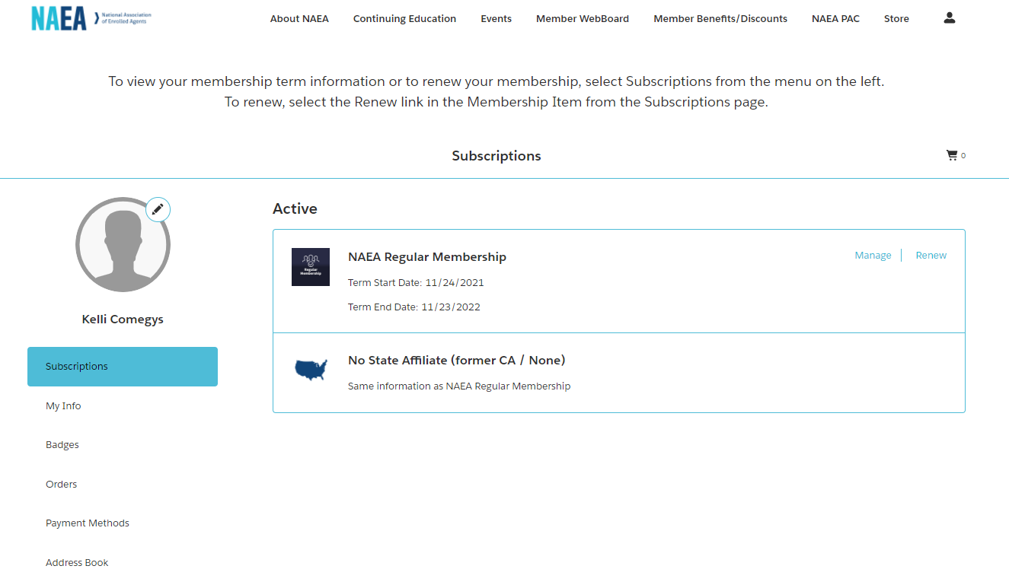
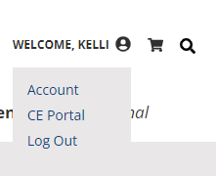
Navigating the NAEA Website
Member Profile
Accessing Benefits
Renewing
CE Portal
Get Involved Form
New Member Page (Coming soon!)
2025 @NAEA All Rights

Slide 4
Free Monthly Member Webinars
Members get access to monthly webinars for networking and CE!
Continuing Education
On-Demand Library
The NAEA Continuing Education Portal offers a wide variety of education topics at every learning level.
Your one stop shop for continuing education needs no matter your expertise level or learning style.
Live Events
Come meet NAEA in person at a live event! Network, learn, and engage with your peers and colleagues at an upcoming NAEA event.
2025 @NAEA All Rights
Notes:
Share the different types of learning
Free monthly webinars
Solutions rooms
GR updates
Roundtables
Hot topic webinars
These brown bag webinars to ask questions direct to naea team members/committee members for help
Live events
Go over these more in detail on that slide but mention that we do them a few times a year

Slide 5
Upcoming Events
2025 Capitol Hill Fly-In
Washington, D.C.
May 13 – 14, 2025
Schuldiner/Smollan Leadership Academy (SSLA)
Washington, DC
May 15-16, 2025
2025 Tax Summit
Salt Lake City, UT
July 28-30, 2025
Notes:
Post link in chat: https://www.naea.org/tax-summit/

Slide 6
National Tax Practice Institute® (NTPI)
Statute of Limitations (SOLs)
The IRS Examination Process
The IRS Collection Process
The Audit Reconsideration Process
Financial Analysis Process
Trust Fund Recovery Penalty Process
Offers in Compromise
Collection and Examination Appeals
IRS Transcript Analysis
Penalty Abatement Strategies
Non-Filers and SFR Assessments
Basic Installment Agreements
Ethics
FOIA Requests
Internal Revenue Manual
Introduction to Criminal Tax
Bankruptcy and Taxes
Lien Defenses
Spousal Relief
Tax Research and Resources
Managing Confidential Client Data
Case Management Strategies
Marketing
Additional learning opportunities include Ask the Expert Webinars, NTPI Roundtables, and graduate topic webinars.
In order to enroll in the National Tax Practice Institute™ (NTPI®), you must be an enrolled agent*, CPA, or tax attorney.

Slide 7
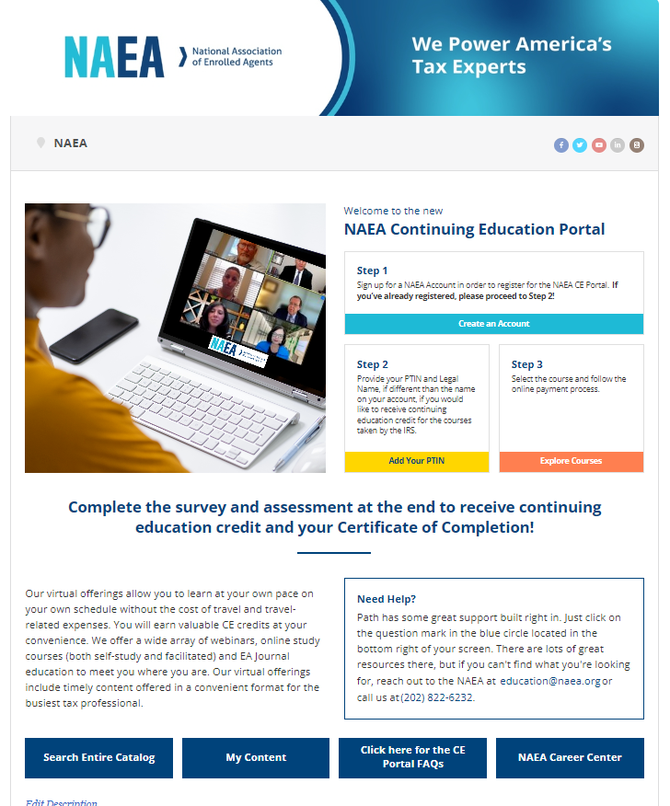
Continuing Education Portal
www.pathlms.com/naea
Our virtual offerings allow you to learn at your own pace on your own schedule without the cost of travel and travel-related expenses. You will earn valuable CE credits at your convenience. Our virtual offerings include timely content offered in a convenient format for the busiest tax professional.
2022 @NAEA All Rights
Notes:
Share the link to path in the chat, recommend they bookmark it! https://www.pathlms.com/naea
Log in to the guest account on an incognito window
Share your screen
Go over below topics:
Logging in – either from profile page or from
Home page highlights
Their profile/ my activity tabs
Faq
Blue buttons
How to search
General course layout
Surveys, materials, certificates
How to get certificates
CE credit breakdown
Our CE reporting timeline
On demand library
Features topics on representation, tax topics, and practice education
Free member webinars section
EA Journal Exam
Searchable by learning level, topic category, CE type, and keywords
Erin Fake Account - Mickey Mouse
U: eashumate@gmail.com
P: Naea1730!!

Slide 8

Continuing Education
Find out about upcoming NAEA events from the NAEA calendar
2025 @NAEA All Rights
Notes:
Share the link for the NAEA event calendar in the chat: https://www.naea.org/events/
Go over the upcoming events – without dates
Tax Summit
Cert programs
NTPI

Slide 9

Continuing Education
Educations Partners
Surgent
Tax Talk Today
Wolters Kluwer
NARSSA
2025 @NAEA All Rights
Notes:
Surgent
For associate members: free part 1, $150 off parts 2 and 3 or off the Premier Pass
Tax experts corner: Surgent also offers NAEA members and guests access to the monthly Tax Experts’ Corner™ series of continuing education courses, curated for Enrolled Agents and Tax Professionals. Each course qualifies for 3 IRS CE hours and is offered to NAEA members at a 10% discount through NAEA.
The Surgent Income Tax School offers comprehensive online tax courses to meet the needs of those just entering the tax profession, as well as experienced tax professionals already in the industry. NAEA members receive 15% off of the Comprehensive Tax Course and the Small Business I and II Tax Courses.
10% discount on all of their CPE
Tax Talk today
NAEA members receive a complimentary View-Only Subscription Package ($100 for non-members). There are no CPE credits earned with the complimentary subscription. Need CPE credits? Tax Talk Today offers several options for purchasing CPE credits. NAEA members receive a 10% discount on the full purchase price of our 15 and 12 credit packages.
Wolters Kluwer is a recognized leader in the tax and accounting industry, providing the latest information impacting CPAs, tax professionals, auditors, financial planners, and other industry professionals. NAEA members can save up 25% off all selected CCH® Publications.
NARSSA: NAEA has partnered with The National Association of Registered Social Security Analysts, the nation’s leading membership organization for accountants and advisors engaged in Social Security advisory. If you want to learn more about Social Security to better serve clients, the RSSA eLearning program is for you. Become an expert Social Security Advisor – a Registered Social Security Analyst. NAEA members save $300 on this program!
-

Slide 10

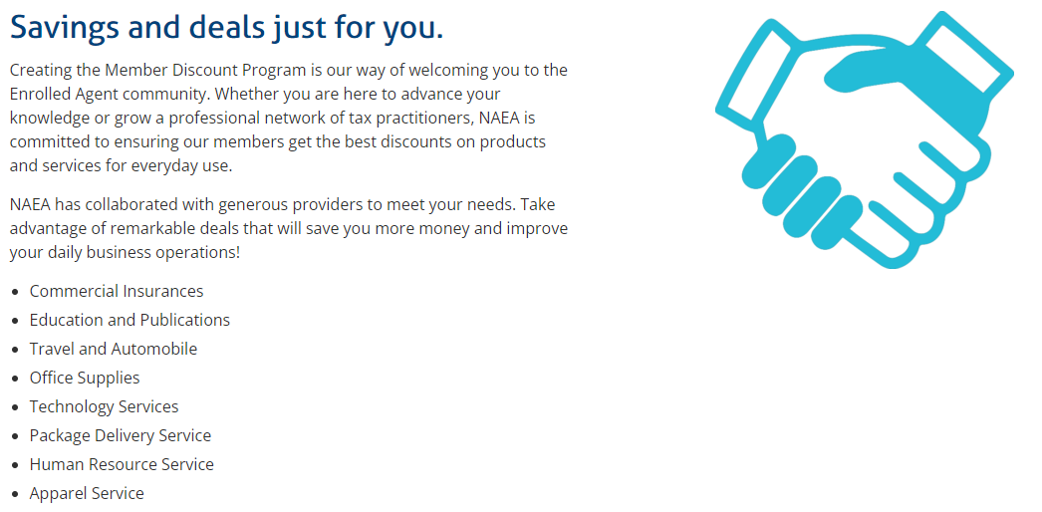
Members Benefits
Tax Season Resources Center
Member Directory & Facebook Group
Member WebBoard
Wellness Center
Find a Tax Expert Directory
State Affiliate
2025 @NAEA All Rights

Slide 11

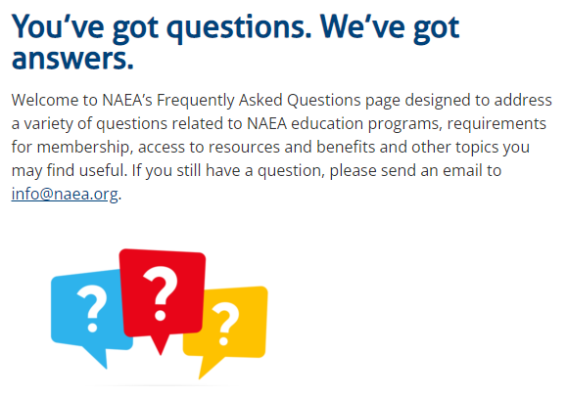
FAQs
https://www.naea.org/about-naea/faq/
2023 @NAEA All Rights

Slide 12
Government Relations Team
Maintains regular contact with congressional leaders and key tax administration officials, works to ensure views of enrolled agents are represented in shaping federal tax policy.
Advocacy
Raising awareness about the enrolled agent profession.
Be the leading voice with governing bodies to address member challenges and effect change.
NAEA PAC
A powerful tool for supporting candidates aligned with NAEA's policy agenda. Engages enrolled agents in advocacy. Increases member involvement and recognition.
NAEA Capitol Fly-In
Come meet your members of Congress at this two-day event May 20-22, 2024! Network with your peers and colleagues. Engage in the political process.
2025 @NAEA All Rights

Slide 13
NAEA Contacts
Kelli Comegys, Sr. Director of Membership Strategy & Development
kcomegys@naea.org
Cassie Renshaw, Chapter Administrator
crenshaw@naea.org
Jessica Masters, Director of Education & Events jmasters@naea.org
Cindy De La Riva, Manager of Education & Events
cdelariva@naea.org
Membership Services membership@naea.org | Education education@naea.org
2025 @NAEA All Rights

Slide 14
Office
1100 G Street NW, Suite 450
Washington, DC 20005, United States
Telephone
(202) 822-6232
Email
info@naea.org

